Slide 1
MQTT and Node-RED and the
Internet of Things
Kirk Carlson
Retired – long time Unix/Linux user
Kirk.Carlson@att.net
github.com/kirkcarlson

Slide 2
MQTT
Message Queueing and Telemetry Transport
Invented at by Andy Stanford-Clark (IBM) and Arlen Nipper (Cirrus Link) in 1999.
A light weight protocol for telemetry and control
While queuing is historically significant, it isn’t necessary for the Internet of Things

Slide 3
MQTT Node Types
Client
  Is an end point that produces or consumes messages
Broker
  Acts as a hub to accept and distribute messages
  Each client typically connects to one broker
  A broker can connect to many clients

Slide 4
MQTT Operations
Uses a Publish-Subscribe or Pub-Sub model
Data producers publish data to a broker
Data consumers subscribe to data from a broker
There is some overhead to establish and release the connections to a broker so connections are normally long lived.

Slide 5
MQTT Common Operations
CONNECT
CONNACK
PUBLISH
SUBSCRIBE
SUBACK

Slide 6
MQTT Less Common Operations
PUBACK, PUBREC, PUBREL, PUBCOMP
UNSUBSCRIBE
UNSUBACK
PINGREQ
PINGRESP/PING
DISCONNECT

Slide 7
MQTT PUB Encoding Basics
Topic (UTF-8 string, no wild cards)
Payload (string, integer, JSON, etc.)
Quality of Service--QoS (0, 1, or 2)
Retention flag (yes, no)
Duplicate (0 initial transmission, 1 repeat)

Slide 8
MQTT SUB Encoding Basics
Payload is list of topics, may use wild cards
  ‘+’ is a wild card to select a single level
  ‘#’ is a wild card to select one or more levels
  A wild card is the only character allowed on a level
  A ‘#’ must be the first or last level
Payload must be UTF-8 encoded string
Requested QoS (0, 1, or 2) for subsequent broker publishes to client

Slide 9
MQTT topic
Just a UTF-8 string of characters
  except ‘+’ and ‘#’
Can be free form, although local rules facilitate wild card use
Current practice uses slashes to delimit levels of a hierarchy to structure the data

Slide 10
Topic Examples
nodename/temperature/unit/value
nodename/humidity/unit/value
nodename/heartbeat
#/value gives all values
nodename/# gives everything from node
+/temperature/# gives all temperatures from all nodes
#/heartbeat give heartbeat from all nodes

Slide 11
MQTT Payload
Variable length
Format is application specific
Strings and integers are easy
A string can be JSON for more complex data

Slide 12
Quality of Service – QoS
QoS 0: At most once or “fire and forget”
QoS 1: At least once
  Message is sent until message ID ACKed
  Message may be duplicated
Qo2 2: Exactly once
  Message is sent until message ID is RECed
  ID is kept by receiver until ID is RELed
  ID is kept by sender until ID is COMPed

Slide 13
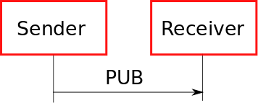
QoS 0 Message Sequence

Slide 14
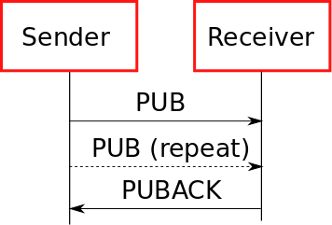
QoS 1 Message Sequence

Slide 15
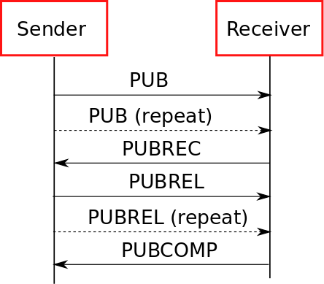
QoS 2 Message Sequence

Slide 16
Node-RED
“They” call it an event wiring tool
It is based on nodes and connections
Focused on message flows
  When a message arrives, do something with it

Slide 17
Implementation
Node-RED has been part of Raspbian for some time
Built with JavaScript on Node.js
It is accessed with a browser
Easy install procedure for Debian and Ubuntu

Slide 18
Using Node-RED
It is extended with node npm modules
  Raspberry Pi GPIO
  Node-RED-Dashboard ***MUST HAVE***
Flows, the user source code, may be shared as JSON which carries the graphic information, attributes, and interconnections

Slide 19
What is a Node?
Something that manipulates a message
Could be an MQTT endpoint
  publisher or subscriber
Could be a function to transform messages
Could be just about any event producer
Could be just about any event consumer

Slide 20
Simplest Node-RED Demo
Two Nodes
  An injection node
  A debugging node
    Just prints what it receives on the debugging window
Configure
  Change injection node topic to “message/first”
  Change injection node payload to “Hello World”
Deploy – compile into JSON and JavaScript

Slide 21
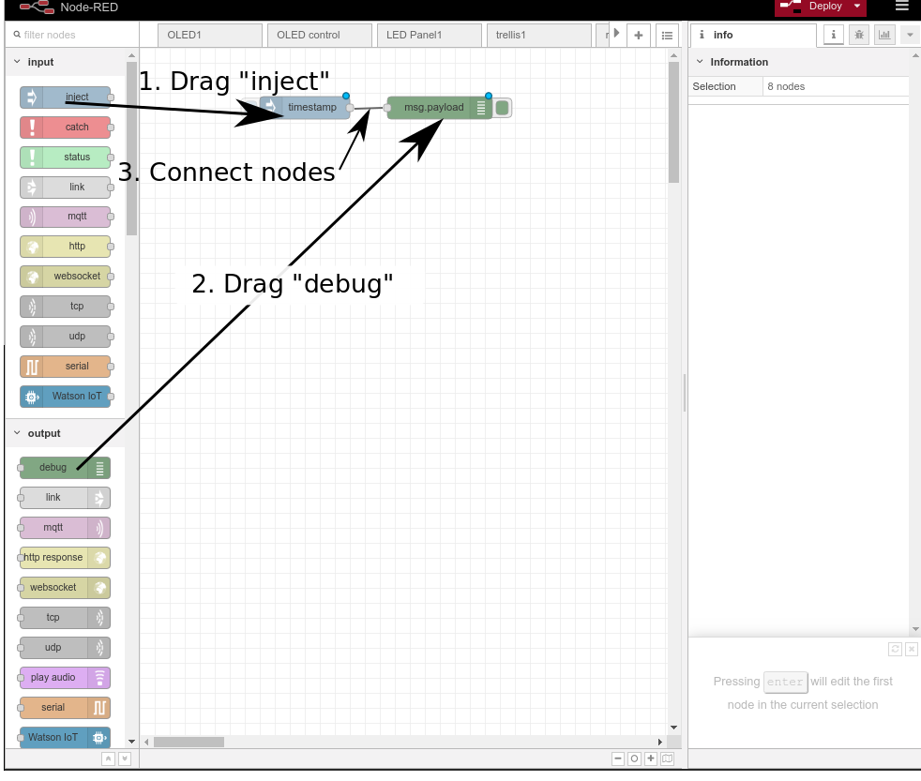
Add nodes and connect

Slide 22
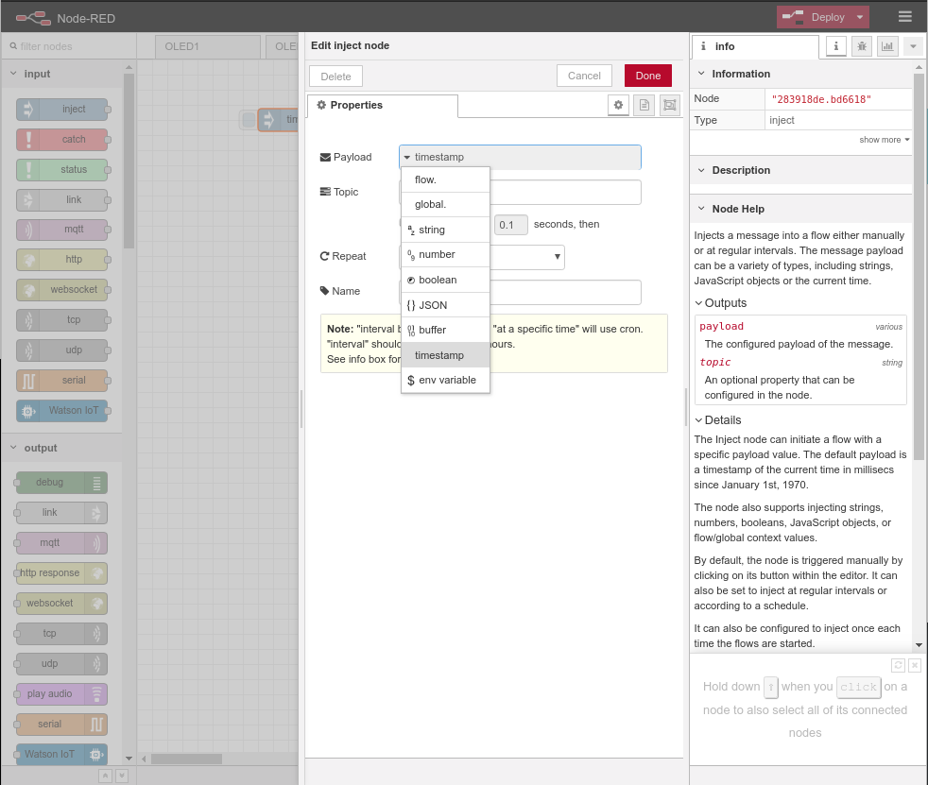
Configure Inject

Slide 23
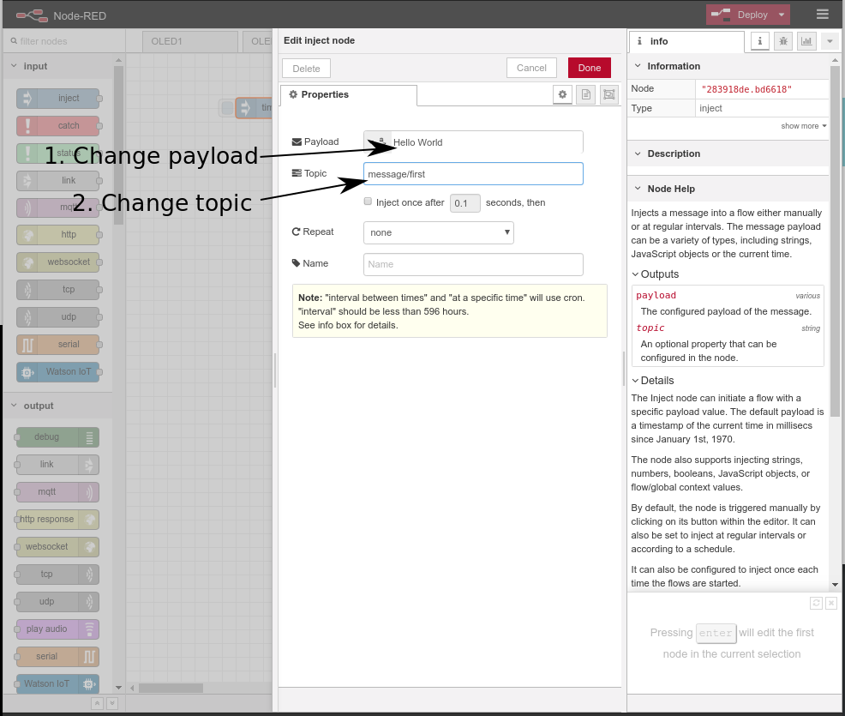
Configure inject (continued)

Slide 24
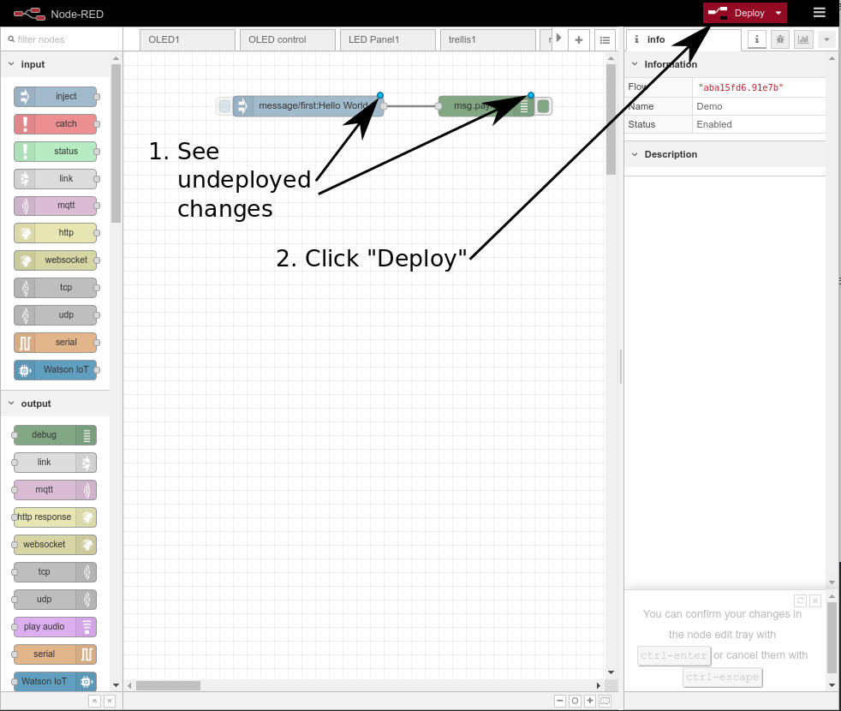
Deploy

Slide 25
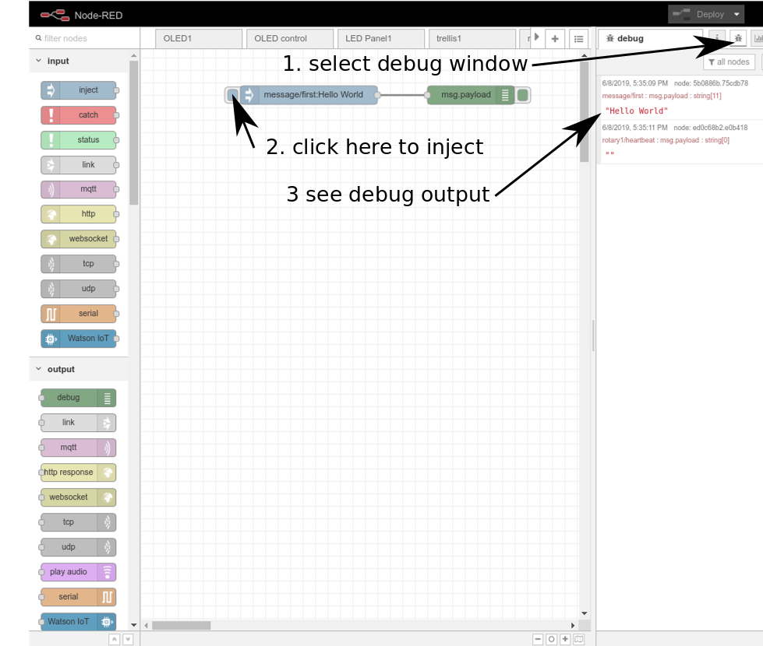
Run it

Slide 26
Simple Function Demo
Subscribe to an MQTT message from a temperature sensor
Send the payload to a MQTT display device
Change the units from Celcius to Farhenheit

Slide 27
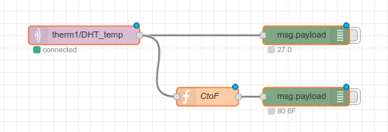
Function demo flow

Slide 28
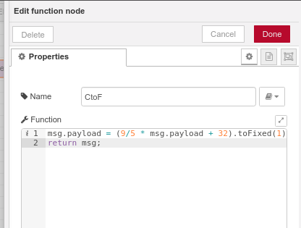
Simple Function

Slide 29
Dashboards
Dashboards allow control access with browser
  Make a button, slider, text input, color selector
  Make a text display, gauge, chart
  Make a noise
Repeat and get creative

Slide 30
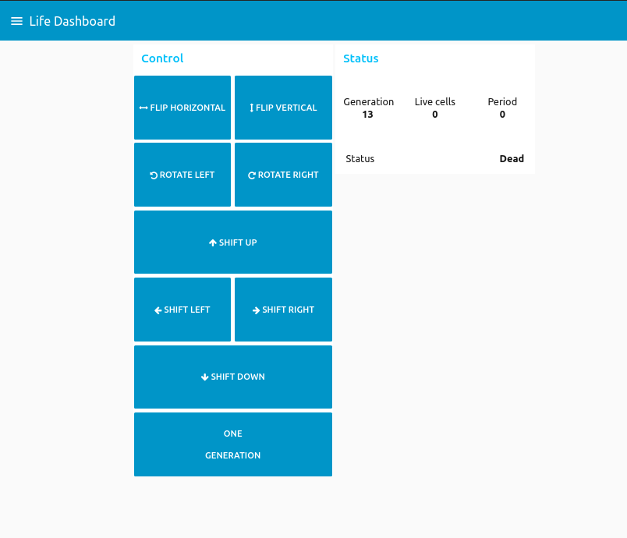
Dashboard Example for Desktop

Slide 31
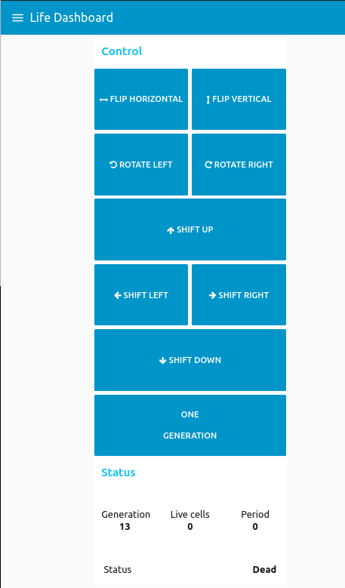
Dashboard Example for Mobile

Slide 32
MQTT Demo
Basic setup is for a STEM fair
Flashing lights to attract the kids
Interactivity to hold attention for a while
Talk about computers, software, messaging, hardware, whatever is of interest
Activity is based around Conway’s Game of Life

Slide 33
Conway’s Game of Life
Count neighboring live cells (0-8)
Alive and 0 or 1 live cells: die from isolation
Alive and 2 or 3 live cells: live for another day
Alive and 4 or more live cells: die from crowding
Dead and exactly three live cells: become live
Great waste of computer resources in 70’s

Slide 34
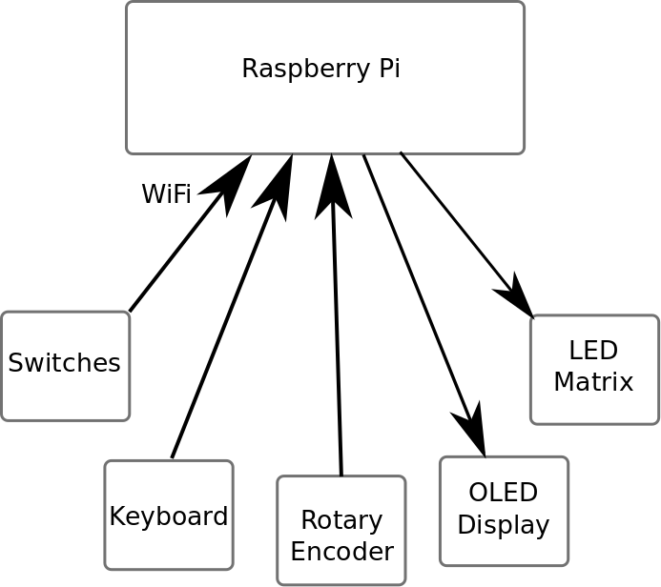
Basic Setup of Demo

Slide 35
MQTT Demo (continued)
Devices are generic and fairly dumb
  Using Particle Photons with particle.io disabled
Node-RED is used to connect devices
Functionality implemented in Node-RED
Dashboard created to allow remote control
  Smart phone
  Desktop browser

Slide 36
Raspberry Pi is Hub
It is a WiFi access point
It serves as the router and DHCP
It is the MQTT broker
It is the Node-RED server
  Provides most of the functionality
It is the dashboard server for a GUI

Slide 37
MQTT Security
Default is ease of use, NOT security
“Can” use TLS as part of TCP transport
“Can” use password authentication
Lots of vulnerabilities beyond this protection

Slide 38
MQTT Presence Detection
Manually register nodes in Node-RED
Do not accept requests from unknown nodes
  Watch global subscriptions (“#/door”, “+/window”)
Add a watchdog timer and heartbeat to nodes
  Detect failing nodes (power, connection, ...)
Report missing or failing nodes
(MQTT connection protects link, not end-to-end)

Slide 39
Use Cases
Collect and display sensor data
Security system
  Secure interfaces
  Intrusion detection
  Attack detection
  Redundancy
    power, comms, sensors, alarms, control
  External monitor and reporting

Slide 40
Attack Surfaces
Device to broker
  WiFi denial of service
  WiFi jamming
  WiFi hijacking
  Node impersonation
  MQTT denial of service
  MQTT jamming

Slide 41
Attack Surfaces (continued)
Broker to Node-RED or vise versa
  Denial of service
  Impersonation (wrong nodes on authorized link)
  Impersonation (publish commands on inbound links)

Slide 42
Attack Surfaces (continued)
Broker to device
  Impersonation (unauthorized commands)
  Impersonation (wrongful acknowledge)
  Denial of service (WiFi and MQTT)
  Jamming (WiFi and MQTT)

Slide 43
Attack Surfaces (continued)
Within Raspberry Pi
  Intercept with false routes
  Administer Node-RED
  Inspect or replace Node-RED files
  Inspect or replace node authorization files?
  Inject messages to Node-RED
  Subscribe to Node-RED feeds

Slide 44
Attack Surfaces (continued)
Power
  Power to the node devices
  Power to the Raspberry Pi
  Power to any required communication equipment
  Primary power – grid?
  Backup power – battery, generator, solar
  Duration of backup

Slide 45
Attack Surfaces (continued)
External Communication Links
  Physically cut wires for phone, SDL, cable
  Illegally jam cell phone
  Illegally hijack cell phone
  Denial of service on recipient
  Denial of service on sender
  Prior fake false negatives masking true positive
  Improper redundancy provisioning

Slide 46
Attack Surfaces (continued)
Node-RED-Dashboard
  No native authentication
  Either add something: password, auth token, ???
  OR consider carefully what you expose

Slide 47
Attack Conclusion
Wireless in general, WiFi in particular, sucks
Wired solutions take more time
Wired solutions are more secure
Encryption secures link data
Bi-directional authentication prevents hijacking and impersonation
Need to separate Pi users and permissions

